Slide 1
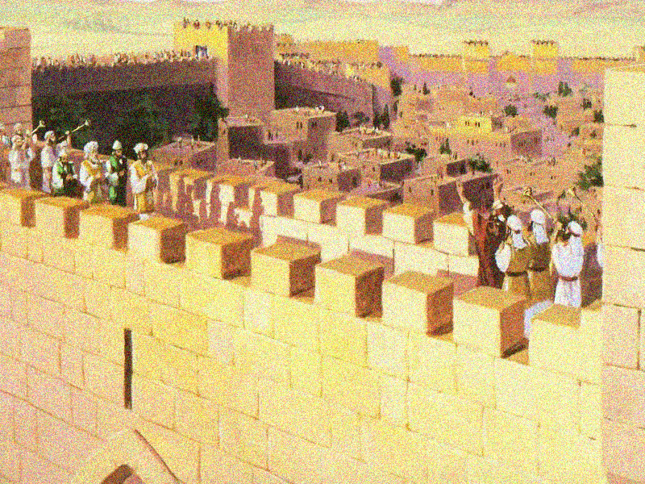
“We’re in God’s army now!”
Nehemiah 11:1-12:47

Slide 2
Nehemiah 11:1-12:47
Family roots

Slide 3
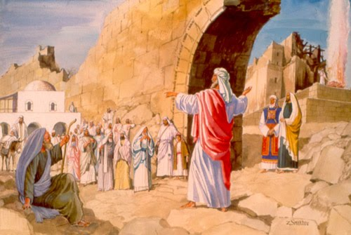
Nehemiah 11:1-12:47
Family roots
Repopulation

Slide 4
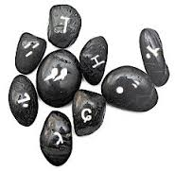
Nehemiah 11:1-12:47
Family roots
Repopulation
Casting lots

Slide 5
Nehemiah 11:1-12:47
Family roots
Repopulation
Casting lots
Volunteers

Slide 6
Nehemiah 11:1-12:47
Family roots
Repopulation
Casting lots
Volunteers
God’s will

Slide 7
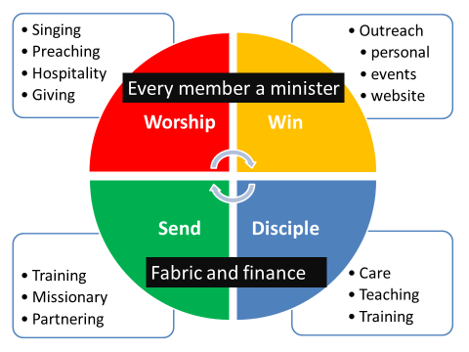
Nehemiah 11:1-12:47
Family roots
Repopulation
Casting lots
Volunteers
God’s will
Grace vision

Slide 8
Nehemiah 11:1-12:47
Family roots
Repopulation
Casting lots
Volunteers
God’s will
Grace vision
Bird’s eye view
Families who repopulated Jerusalem (11:3-24)
‘Ordinary’ families (v.3-9)
Priestly families (v.10-14)
Levitical families, gatekeepers and temple workers (vv.15-24)
2. Scattered families of Judah and Benjamin (v.25-36)
3. Priests and Levites from time of Zerubbabel (12:1-9)
4. The high priests (v.10-11)
5. Heads of priestly and Levitical families (v.12-26)
6. Dedication of the wall (v.27-43)
7. Organisation of temple support (v.44-47)

Slide 9
Nehemiah 11:1-12:47
Ministry = living where God wants to you to live

Slide 10
Nehemiah 11:1-12:47
Ministry = living where God wants to you to live
Where does God want us to live?

Slide 11
Nehemiah 11:1-12:47
Ministry = living where God wants to you to live
Where does God want us to live?
Remember: heaven is a city, not a resort!

Slide 12
Nehemiah 11:1-12:47
Ministry = living where God wants to you to live
Ministry = using God-given gifts

Slide 13
Nehemiah 11:1-12:47
Ministry = living where God wants to you to live
Ministry = using God-given gifts
Body of Christ – see 1 Corinthians 12:12-30

Slide 14
Nehemiah 11:1-12:47
Ministry = living where God wants to you to live
Ministry = using God-given gifts
Body of Christ – see 1 Corinthians 12:12-30
Identification of gifts – “the person who complains, ‘this isn’t a caring church’ is probably a caring person. He who complains about a lack of organisation might well be a gifted administrator!”

Slide 15
Nehemiah 11:1-12:47
Ministry = living where God wants to you to live
Ministry = using God-given gifts
Ministry – faithfully serving in the shadows

Slide 16
Nehemiah 11:1-12:47
Ministry = living where God wants to you to live
Ministry = using God-given gifts
Ministry – faithfully serving in the shadows
Anonymous ‘associates’ – 128 brave warriors (v.13)

Slide 17
Nehemiah 11:1-12:47
Ministry = living where God wants to you to live
Ministry = using God-given gifts
Ministry – faithfully serving in the shadows
Anonymous ‘associates’ – 128 brave warriors (v.13)
Seek faithfulness not fame

Slide 18
Nehemiah 11:1-12:47
Ministry = living where God wants to you to live
Ministry = using God-given gifts
Ministry – faithfully serving in the shadows
Anonymous ‘associates’ – 128 brave warriors (v.13)
Seek faithfulness not fame
Ignored by men, noticed by God

Slide 19
Nehemiah 11:1-12:47
Ministry = living where God wants to you to live
Ministry = using God-given gifts
Ministry – faithfully serving in the shadows
Ministry = people first, programmes second

Slide 20
Nehemiah 11:1-12:47
Ministry = living where God wants to you to live
Ministry = using God-given gifts
Ministry – faithfully serving in the shadows
Ministry = people first, programmes second
“He who enters by the door is the shepherd of the sheep…he calls his own sheep by name and leads them out…he goes before them, and the sheep follow him, for they know his voice” (John 10:2-4)

Slide 21
Nehemiah 11:1-12:47
Ministry = living where God wants to you to live
Ministry = using God-given gifts
Ministry – faithfully serving in the shadows
Ministry = people first, programmes second
Ministry through relationships

Slide 22
Nehemiah 11:1-12:47
Ministry = living where God wants to you to live
Ministry = using God-given gifts
Ministry – faithfully serving in the shadows
Ministry = people first, programmes second
Requirements for ministry

Slide 23
Nehemiah 11:1-12:47
Ministry = living where God wants to you to live
Ministry = using God-given gifts
Ministry – faithfully serving in the shadows
Ministry = people first, programmes second
Requirements for ministry
A pure heart: “when the priests and the Levites had purified themselves…they purified the people, the gates and the wall” (12:30)

Slide 24
Nehemiah 11:1-12:47
Ministry = living where God wants to you to live
Ministry = using God-given gifts
Ministry – faithfully serving in the shadows
Ministry = people first, programmes second
Requirements for ministry
A pure heart
A worshipping heart: “At the dedication of the wall…, the Levites…were brought to Jerusalem to celebrate joyfully…with songs of thanksgiving” (v.27)

Slide 25
Nehemiah 11:1-12:47
Ministry = living where God wants to you to live
Ministry = using God-given gifts
Ministry – faithfully serving in the shadows
Ministry = people first, programmes second
Requirements for ministry
A pure heart
A worshipping heart
Sad that worship has become a bone of contention

Slide 26
Nehemiah 11:1-12:47
Ministry = living where God wants to you to live
Ministry = using God-given gifts
Ministry – faithfully serving in the shadows
Ministry = people first, programmes second
Requirements for ministry
A pure heart
A worshipping heart
Sad that worship has become a bone of contention
Worship = “worth-ship!” (Raymond Brown)

Slide 27
Nehemiah 11:1-12:47
Ministry = living where God wants to you to live
Ministry = using God-given gifts
Ministry – faithfully serving in the shadows
Ministry = people first, programmes second
Requirements for ministry
A pure heart
A worshipping heart
A joyful heart: “on that day they offered great sacrifices, rejoicing because God had given them great joy. The women and the children also rejoiced. The sound of rejoicing could be heard far away” (v.43).

Slide 28
Nehemiah 11:1-12:47
Ministry = living where God wants to you to live
Ministry = using God-given gifts
Ministry – faithfully serving in the shadows
Ministry = people first, programmes second
Requirements for ministry
A pure heart
A worshipping heart
A joyful heart
A giving heart: “In the days of Zerubbabel and of Nehemiah, all Israel contributed the daily portions for the singers and gatekeepers. They also set aside the portion for the other Levites and the Levites set aside the portion for the priests” (v.47)

Slide 29
Nehemiah 11:1-12:47
Ministry = living where God wants to you to live
Ministry = using God-given gifts
Ministry – faithfully serving in the shadows
Ministry = people first, programmes second
Requirements for ministry
A pure heart
A worshipping heart
A joyful heart
A giving heart
NT church: 1 Cor. 16: 2 + 1 Peter 4:9 “offer hospitality to each other without grumbling!”

Slide 30
Nehemiah 11:1-12:47
Ministry = living where God wants to you to live
Ministry = using God-given gifts
Ministry – faithfully serving in the shadows
Ministry = people first, programmes second
Requirements for ministry
Conclusion:
William Carey - “My business is to extend the kingdom of God. I only cobble shoes to pay expenses!”

